Slide 1

BANK CUSTOMER
CHURN

Slide 2
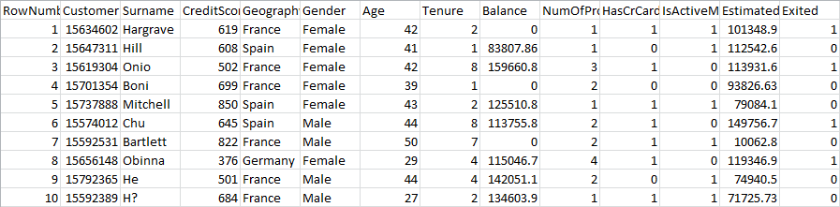
DATASET
3 categorical
11 numerical
10000 rows
14 columns

Slide 3

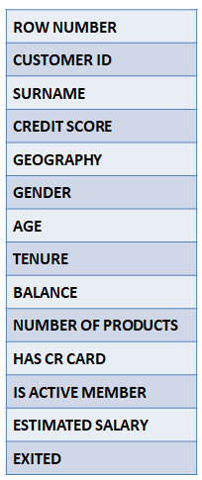

PREPROCESSING
Deletion of columns
Factor and Levels
Range Values

Slide 4
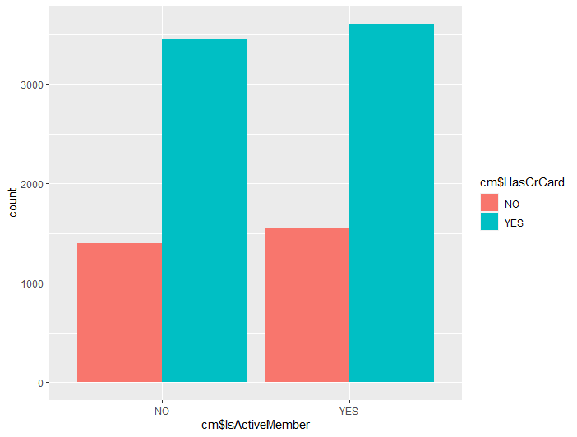
ACTIVE MEMBER
V/S
CREDIT CARD
WRONG ASSUMPTION !!!

Slide 5
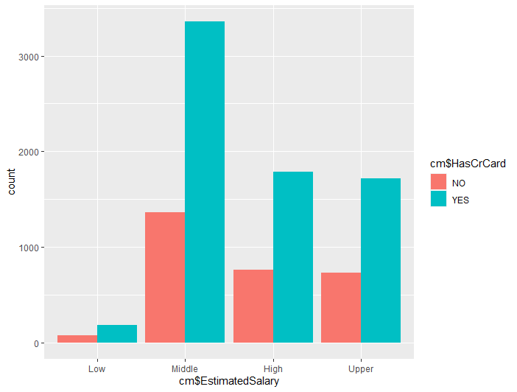
ESTIMATED SALARY
V/S
CREDIT CARD

Slide 6

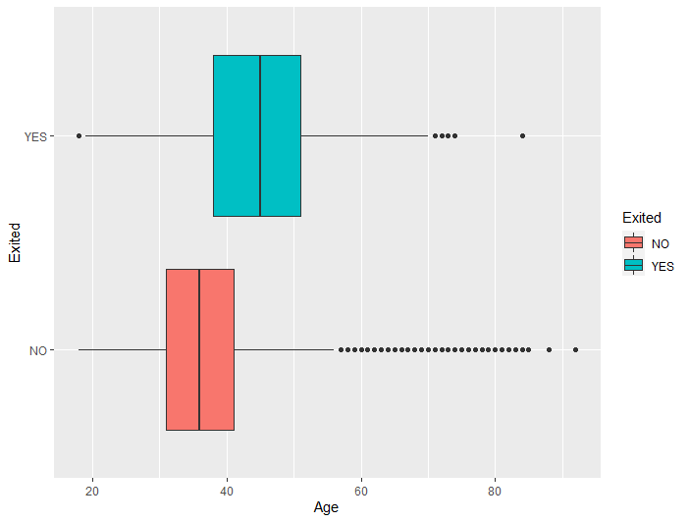
AGE
V/S
EXITED

Slide 7
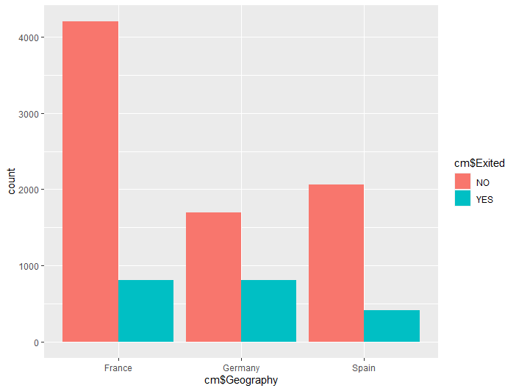
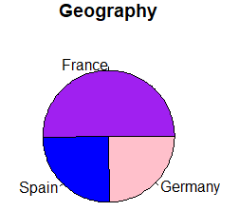
GEOGRAPHY

Slide 8
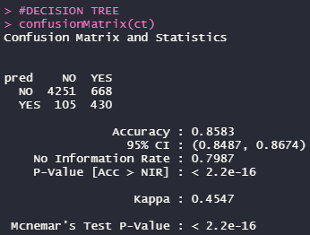
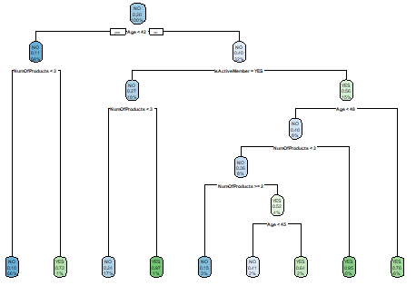
DECISION TREE
85.83%

Slide 9
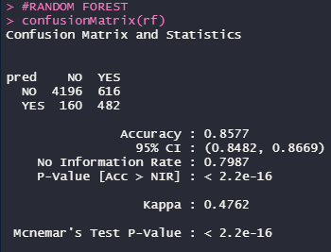
RANDOM FOREST
85.77%

Slide 10

LOGISTIC REGRESSION
81.11%

Slide 11
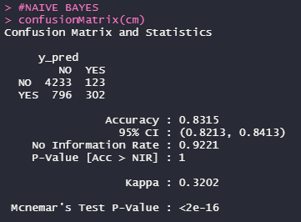
NAIVE BAYES
83.15%

Slide 12
CONCLUSION
Best Model: Decision Tree
Accuracy: 85.83%

Slide 13
THANK YOU

